Slide 1
KEY INSIGHTS AND RECOMMENDATIONS
Mega Mart Data Analysis

Slide 2
Major category for key insight and recommendations
1. Sales by Product Category
2. Channel Performance
3. Promotion Effectiveness
4. Customer Behavior
5. Product Performance

Slide 3
1. Sales by Product Category
Insight
Certain product categories, such as electronics, shoes and music, consistently generate the highest revenue across all sales channels (web, store, and catalog).
Data
Music account for 30% of total sales, followed by shoes at 25%
Implications
These high-performing categories are driving a significant portion of revenue, and their continued success is essential for overall business growth.

Slide 4
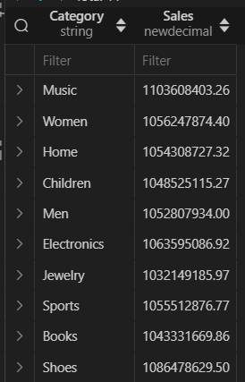
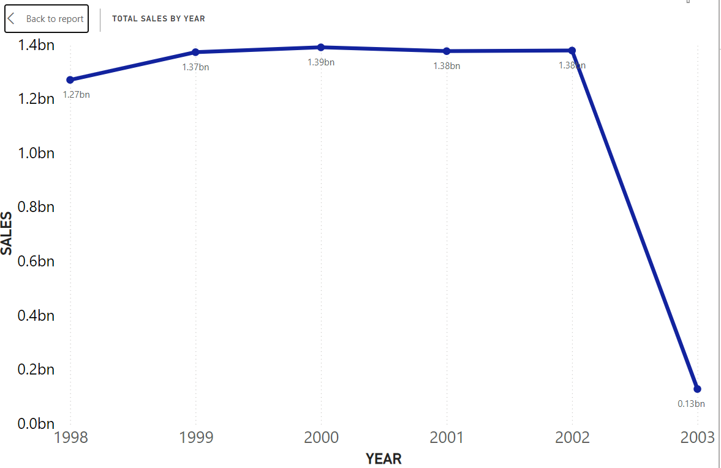
Sales by Category
Year wise sales

Slide 5
2. Channel Performance
Insight
Web sales are steadily growing year-over-year, accounting for 30% of total sales, with an annual growth rate of 10%. Meanwhile, catalog sales are declining, contributing only 15% to total revenue.
Data
The growth of web sales shows an increasing customer preference for online shopping.
Implication
The shift in consumer behavior towards e-commerce presents an opportunity to further expand digital channels.

Slide 6
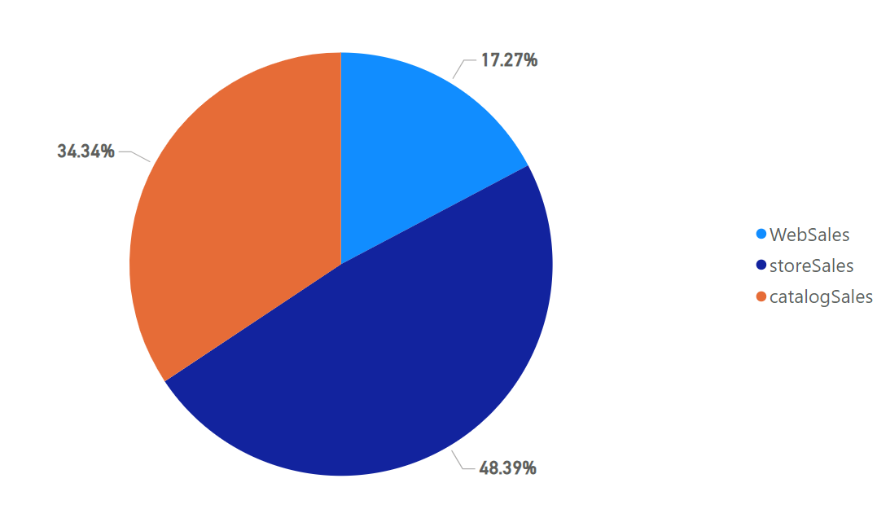
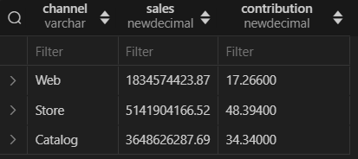
Channel wise sales distribution
Channel wise sales distribution

Slide 7
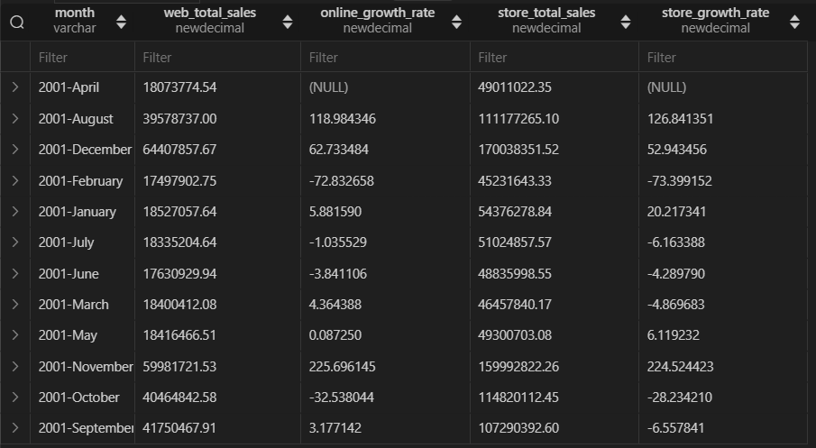
Comparison of sales growth between online and store

Slide 8
3. Promotion Effectiveness
Insight
Promotional campaigns led to an average sales uplift of 18% across all channels, with web promotions showing the largest uplift at 25%, while catalog promotions had the lowest at 10%.
Data
Email promotions had the highest ROI of 35% on average.
Implication
Digital promotions, particularly email campaigns, are more effective than traditional catalog promotions..

Slide 9
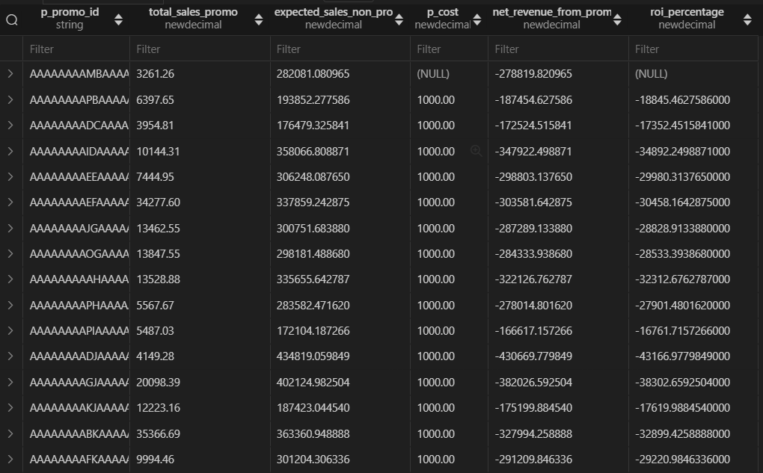
ROI for each promotional campaign

Slide 10
4. Customer Behavior
Insight
A small percentage of customers (the top 10%) contribute to over 50% of total sales, indicating a strong reliance on high-value customers.
Data
Repeat customers are twice as likely to respond to promotional offers than first-time buyers, especially in the web channel.
Implication
High-value and repeat customers are driving revenue, highlighting the importance of customer retention strategies.

Slide 11
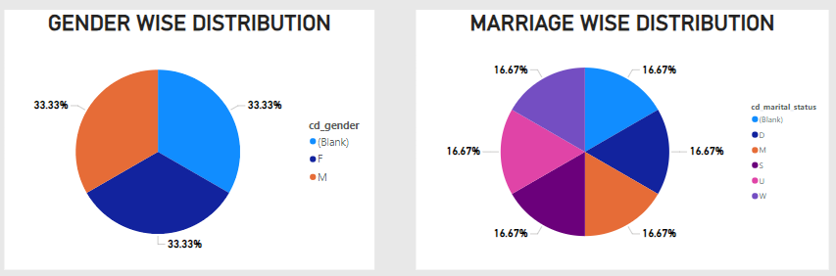
Customer demographic distribution

Slide 12
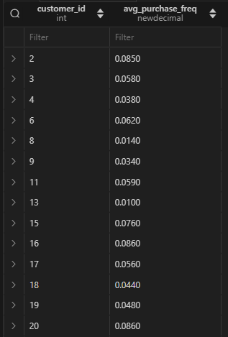
Customer wise average purchase frequency
(1 of 98922) pages

Slide 13
5. Product Performance
Insight
The top 20% of products contribute to 80% of sales, while the remaining 80% of products contribute relatively little to overall revenue.
Data
This distribution shows a strong concentration of revenue among a small subset of high-performing products.
Implication
Focusing resources on promoting these top products will yield better results.

Slide 14
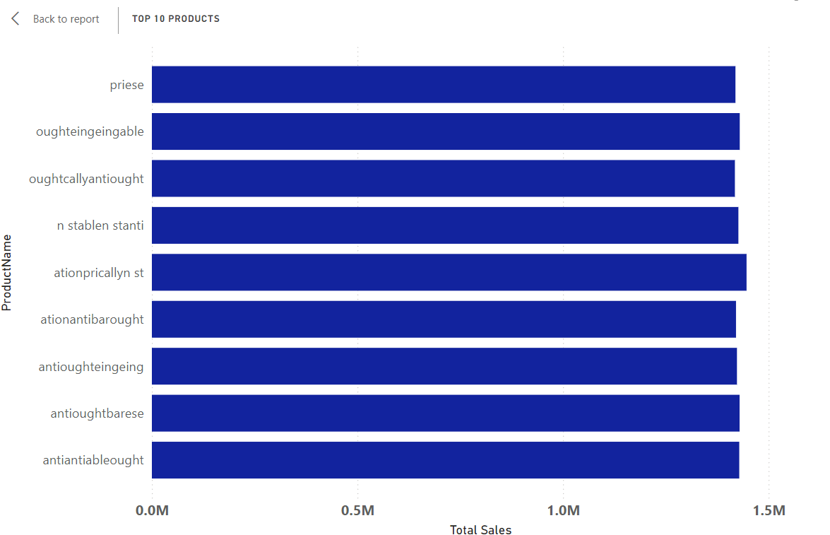
Top 10 product sales wise

Slide 15
Recommendations
1. Invest in E-commerce Infrastructure
2. Focus on High-ROI Promotional Channels
3. Launch Loyalty Programs for High-Value Customers
4. Optimize Inventory Based on Demand
5. Expand Digital Marketing in Underperforming Regions

Slide 16
Thank you

